Slide 1
颜色转换模型及点运算
Matlab图像处理编程实践初步
肖俊
浙江大学计算机学院
2021

Slide 2
内容提要
颜色模型基础
颜色模型转换
图像的点运算
点运算的种类
直方图与点运算
直方图的均衡化
直方图规定化
图像的直方图特征

Slide 3
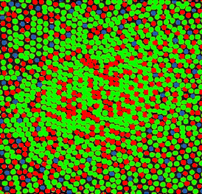
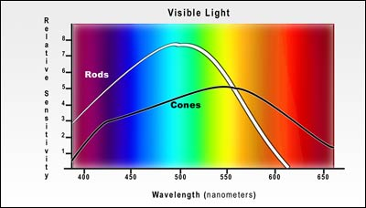
1.1 Light and Spectra
Spectral Sensitivity of the Eye (Conti. )
Rods – broad range wavelengths, perception of Black-White
About 6 million cones – color R:G:B=40:20:1
Response in the eye to the falling light
Spectral Sensitivity of Rods and Cones

Slide 4
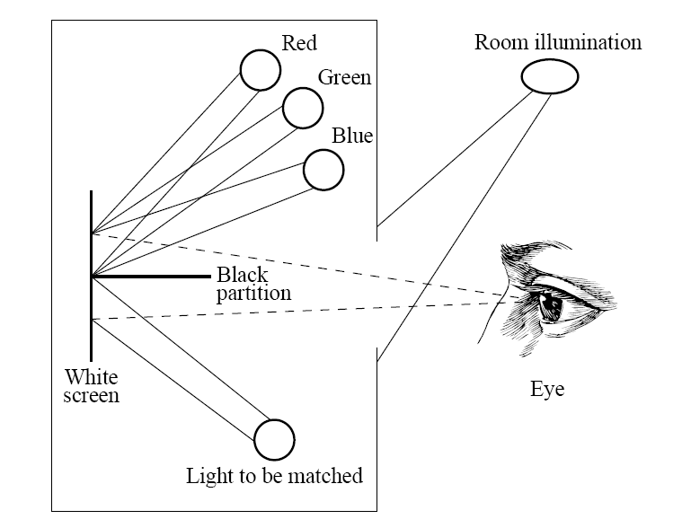
1.3 Color-Matching Functions
Fig. 4.8: colorimeter experiment.
Red: 700nm
Green: 546.1nm
Blue: 435.8nm

Slide 5
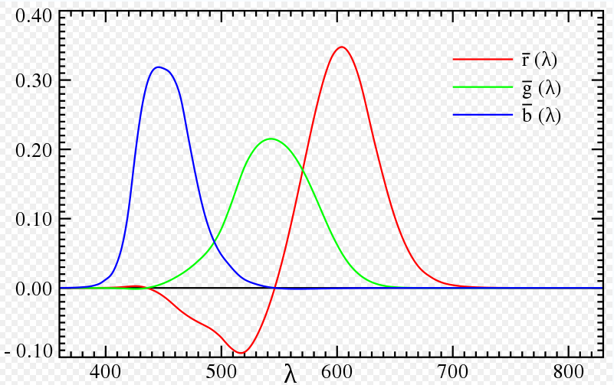
1.3 Color-Matching Functions
• The amounts of R, G, and B the subject selects to match each single-wavelength light forms the color-matching curves. These are denoted and are shown in Fig. 4.9.
.
Fig. 4.9: CIE RGB color-matching functions

Slide 6
1.3 Color-Matching Functions
• Since the color-matching curve has a negative lobe, a set of fictitious primaries were devised that lead to color-matching functions with only positives values.
(a) The resulting curves are shown in Fig. 4.10; these are usually referred to as the color-matching functions.
(b) They are a 3 × 3 matrix away from curves, and are denoted .
(c) The matrix is chosen such that the middle standard color-matching function exactly equals the luminous-efficiency curve V(λ) shown in Fig. 4.3.

Slide 7
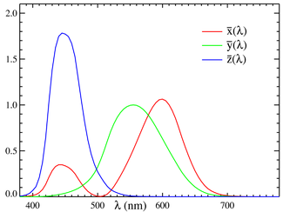
1.3 Color-Matching Functions
CIE standard color-matching functions: CIE XYZ Color Space

Slide 8
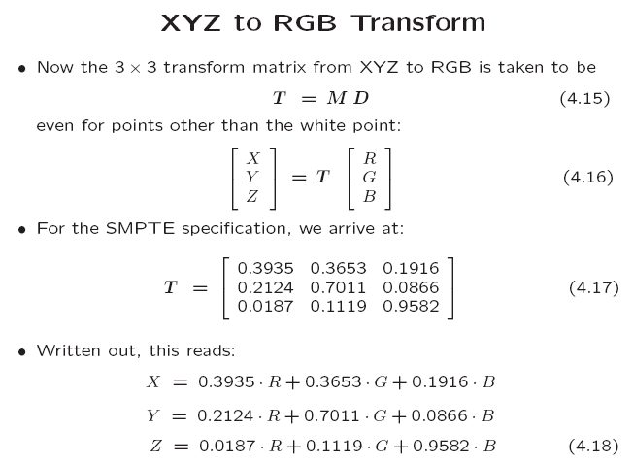

Slide 9
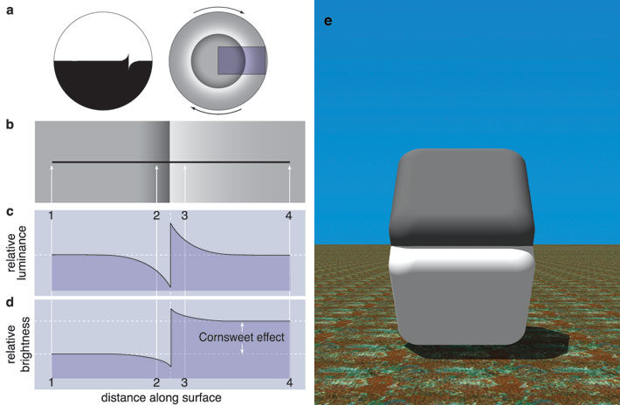
Color Perception: the Cornsweet Effect
The top is darker…
…than the bottom,
Right?
Dale Purves, R. Beau Lotto, Surajit Nundy, “Why We See What We Do”, American Scientist, Volume 90, No. 3, May-June 2002

Slide 10
Color Perception: the Cornsweet Effect
Wrong!
Dale Purves, R. Beau Lotto, Surajit Nundy, “Why We See What We Do”, American Scientist, Volume 90, No. 3, May-June 2002

Slide 11
Color Perception: the Cornsweet Effect
Dale Purves, R. Beau Lotto, Surajit Nundy, “Why We See What We Do”, American Scientist, Volume 90, No. 3, May-June 2002

Slide 12
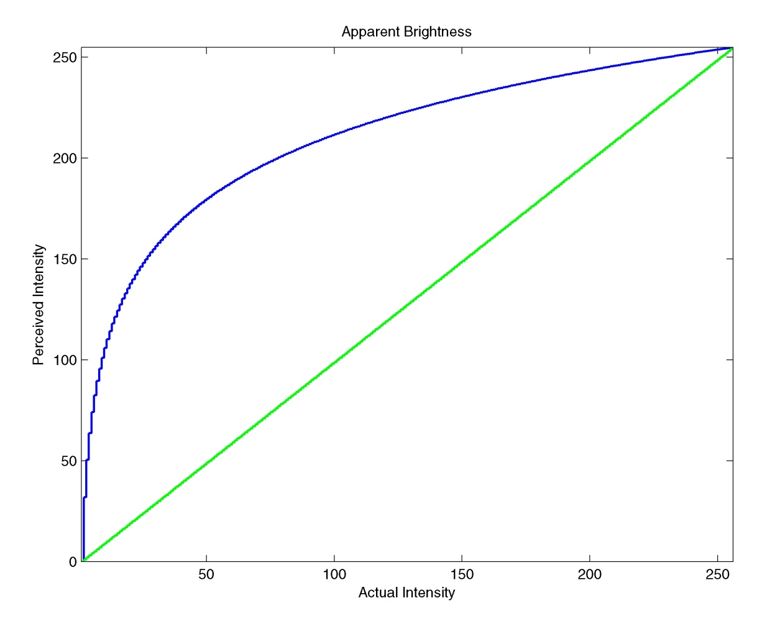
Brightness Perception
The linear slope of the intensity change is perceived as logarithmic.
The green curve is the actual intensity; the blue curve is the perceived intensity.

Slide 13

1.4 L*a*b*(CIELAB) Color Model
Weber’s Law（From psychology）
The more there is of a quantity，the more changes there must be to perceive a difference
Changes are about equally perceived if the ratio of the change is the same
A logarithmic approximation
50->100, 100%
100->150, 50%

Slide 14
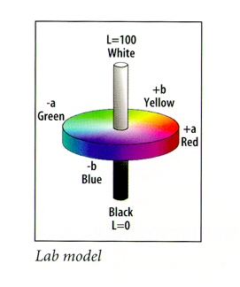
1.5 L*a*b*(CIELAB) Color Model
CIE – Human vision: CIELAB space, called L*a*b*
Three value – Luminance, Colorfulness and Hue
Using Power law of 1/3 – instead of logarithm

Slide 15
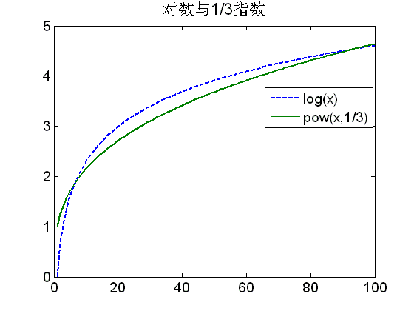
1.3 L*a*b*(CIELAB) Color Model
Logarithm close to the power law of 1/3

Slide 16
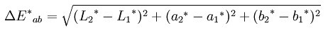
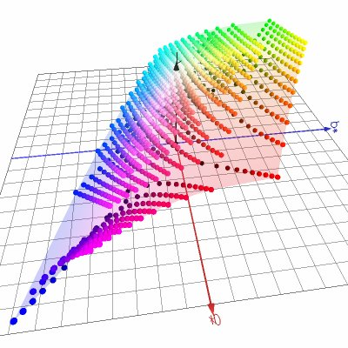
1.3 L*a*b*(CIELAB) Color Model
The color difference is defined as
where,
L*a*b* space
With Xn, Yn, Zn the XYZ value of the white point

Slide 17
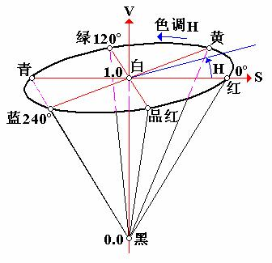
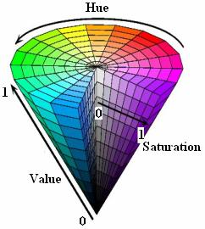
1.4 Other color models
HSL(HSB)－Hue, Saturation, Lightness/Brightness.
HSV --Hue Saturation Value
HIS -- Hue，Saturation and Intensity
HCI -- C= Chroma
HVC -- V＝value
HSD -- D=Darkness
CMY
…

Slide 18
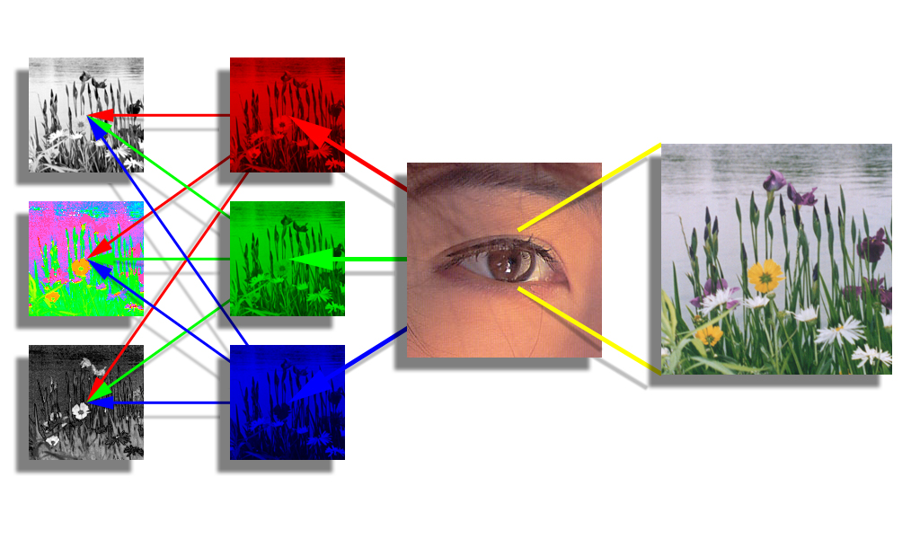
1.4 Other color models
In the Brain: from RGB to LHS
luminance
The eye has 3 types of photoreceptors:
sensitive to red, green, or blue light.
hue
saturation
The brain transforms RGB into separate brightness and color channels (e.g., LHS).
brain
photo receptors

Slide 19
2. Color Models in Images
RGB color model for CRT Display
CMY color model
Transformation from RBG to CMY
CMYK color system

Slide 20
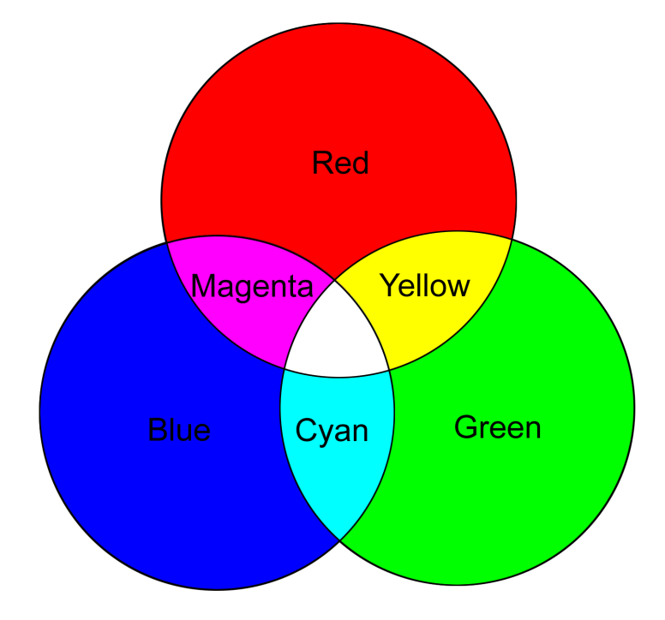
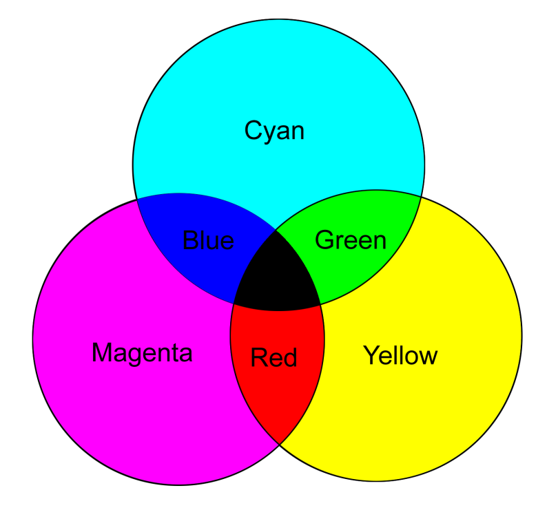
2.2 Subtractive Color: CMY
Additive and subtractive color
RGB is additive color; CMYK is subtractive color

Slide 21
2.3 Transformation from RBG to CMY
The inverse transform

Slide 22
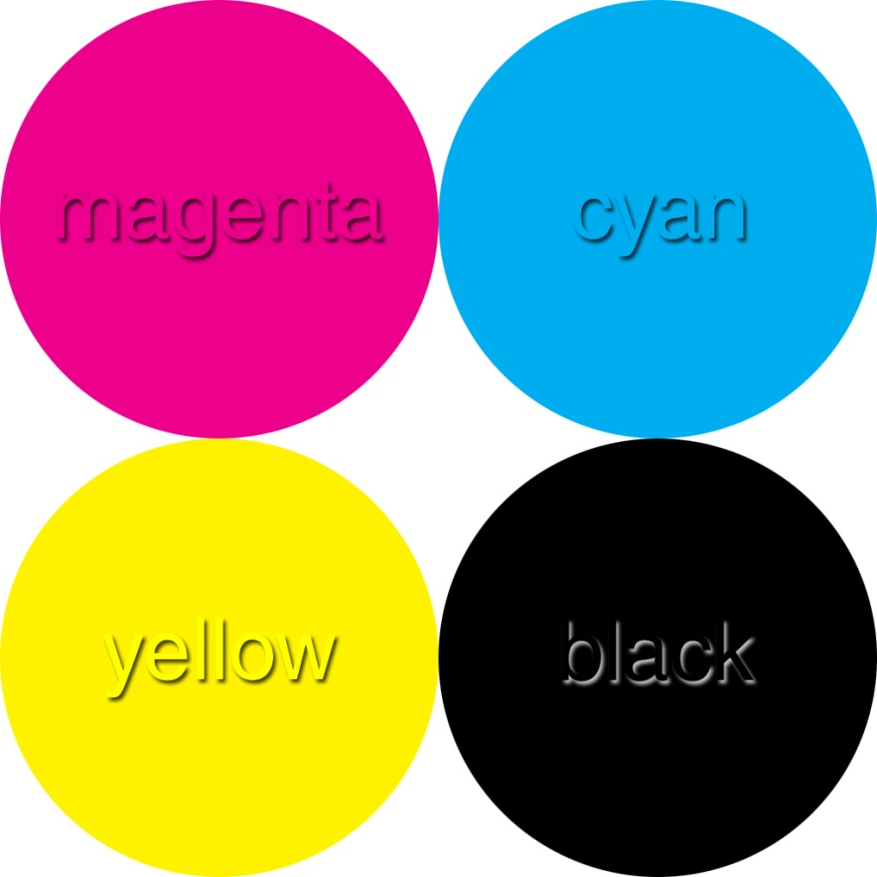
2.4 Under color Removal : CMYK
CMYK system get the “true” black by adding K component

Slide 23
Answers
Color inkjet printers use the CMY model. When the cyan ink color is sprayed onto a sheet of white paper,
Why does it look cyan under daylight?
What color would it appear under a blue light? Why?

Slide 24
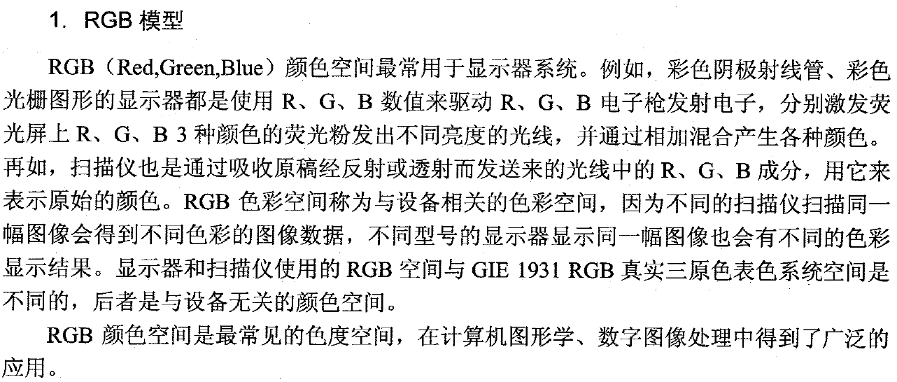
颜色模型转换

Slide 25
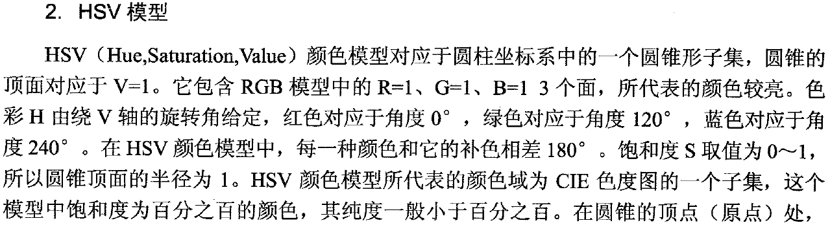
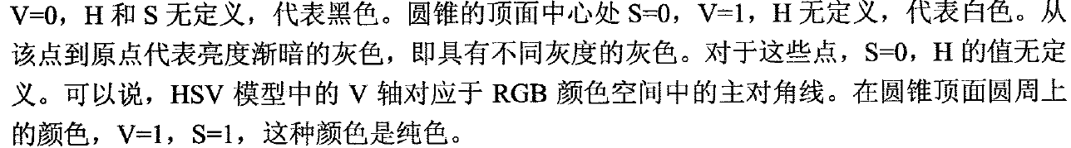
颜色模型转换

Slide 26
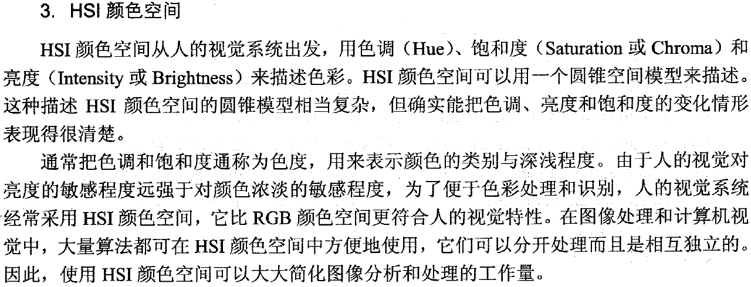
颜色模型转换

Slide 27
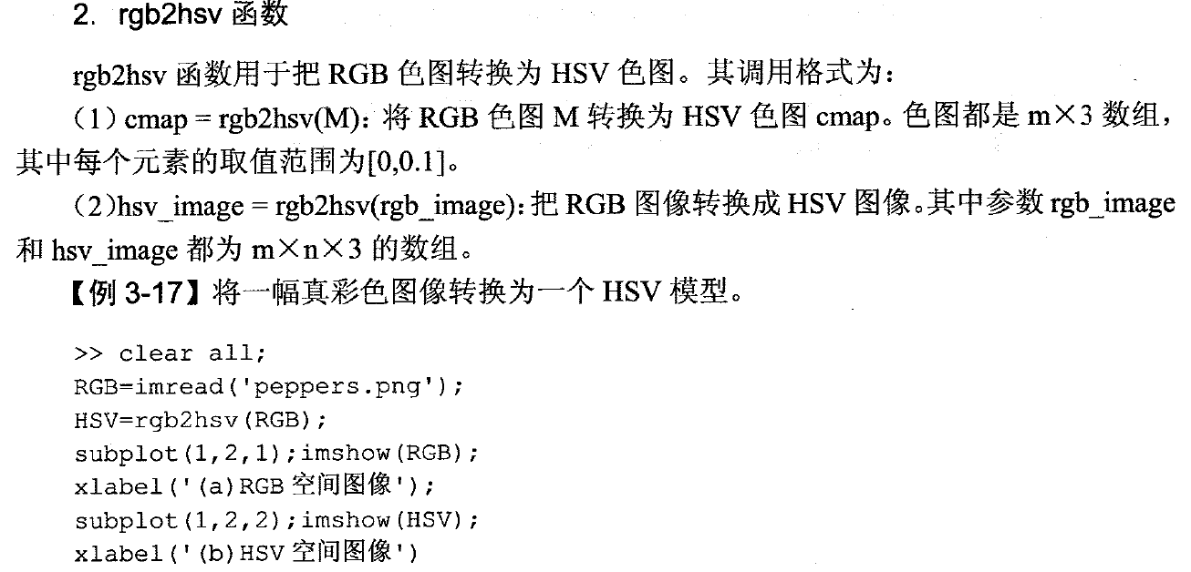
颜色模型转换

Slide 28
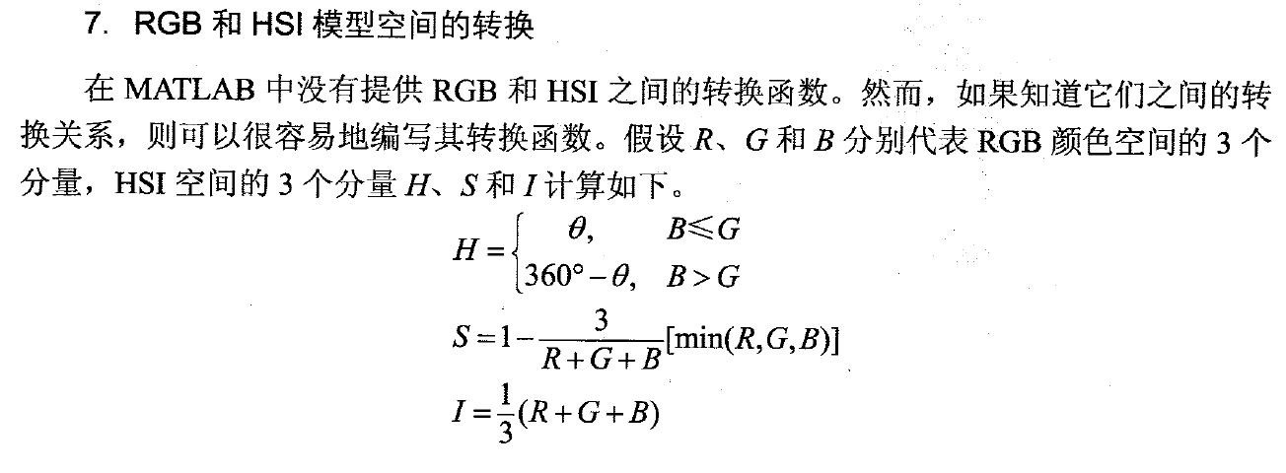
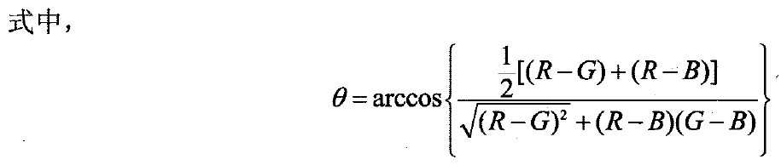
颜色模型转换

Slide 29
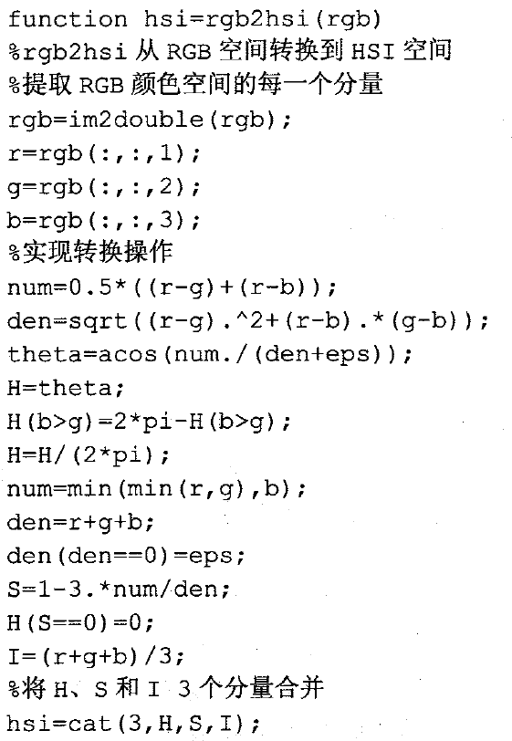
颜色模型转换

Slide 30
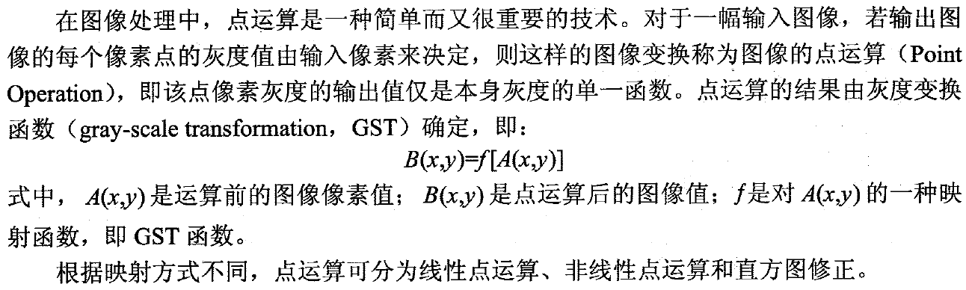
图像的点运算

Slide 31
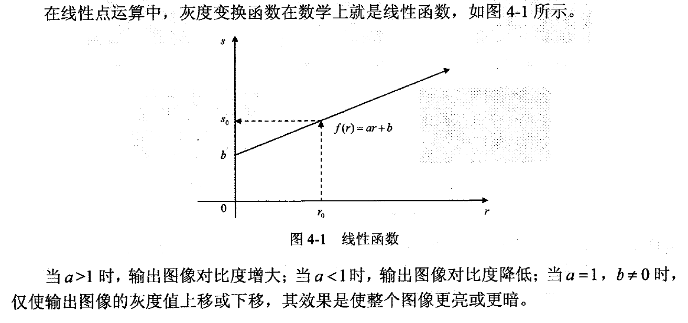
图像的点运算——线性点运算

Slide 32
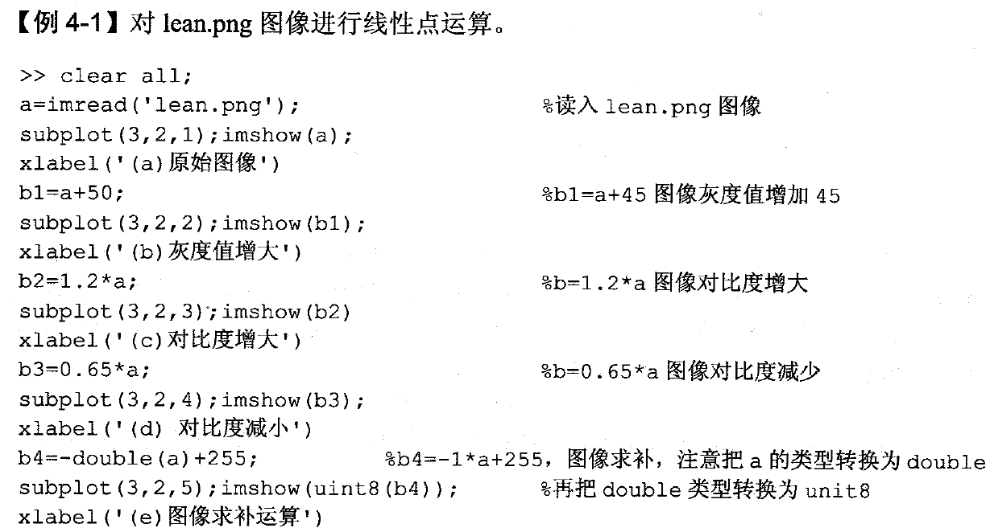
图像的点运算——线性点运算

Slide 33
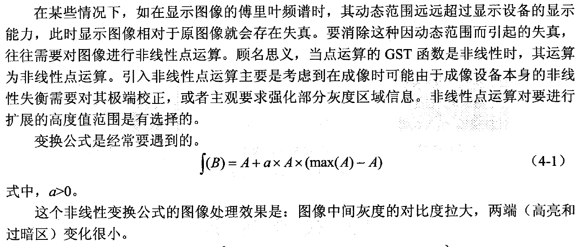
图像的点运算——非线性点运算

Slide 34
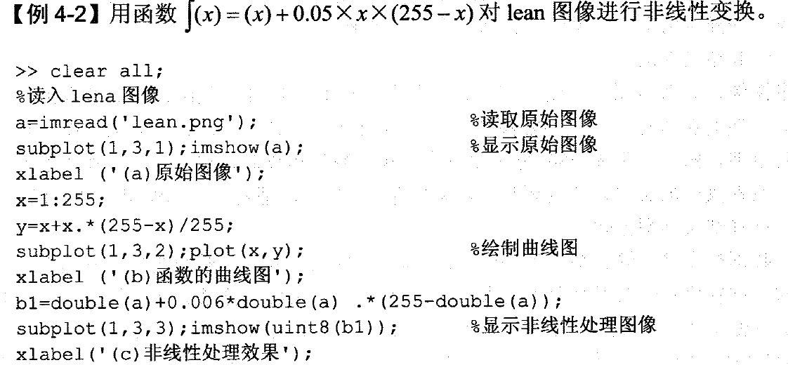
图像的点运算——非线性点运算

Slide 35
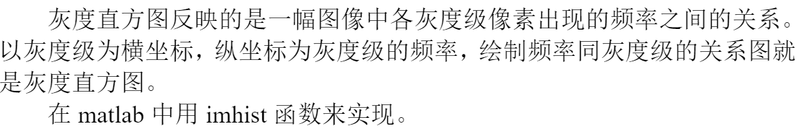
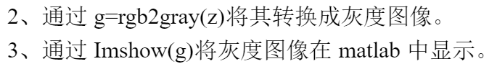
图像的直方图特征

Slide 36
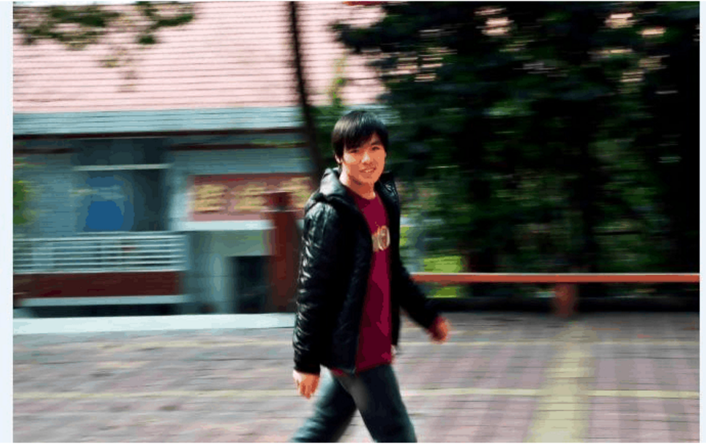
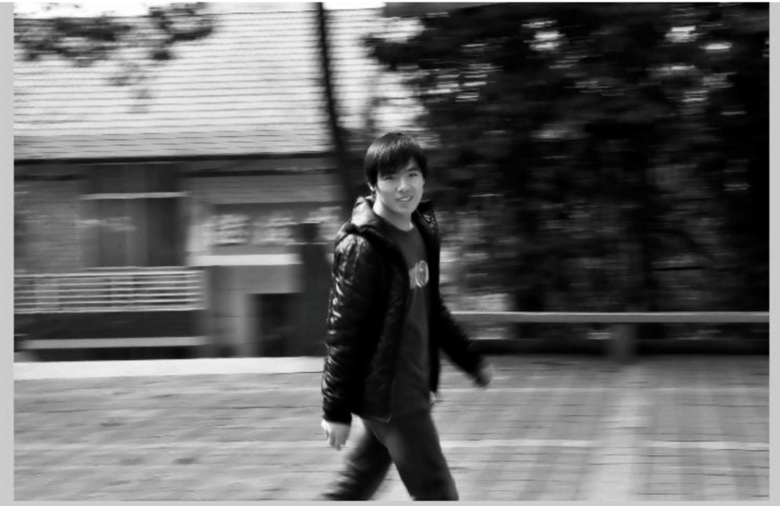
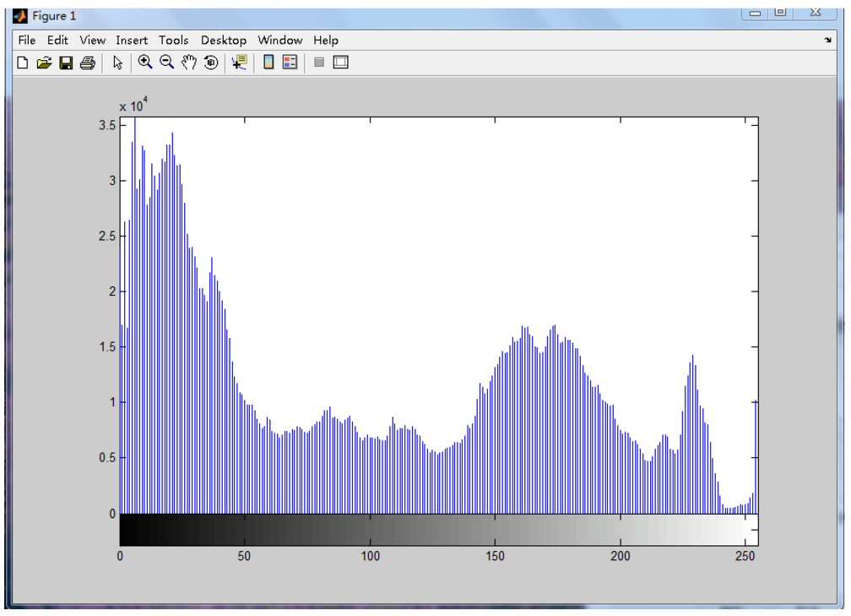
图像的直方图特征

Slide 37
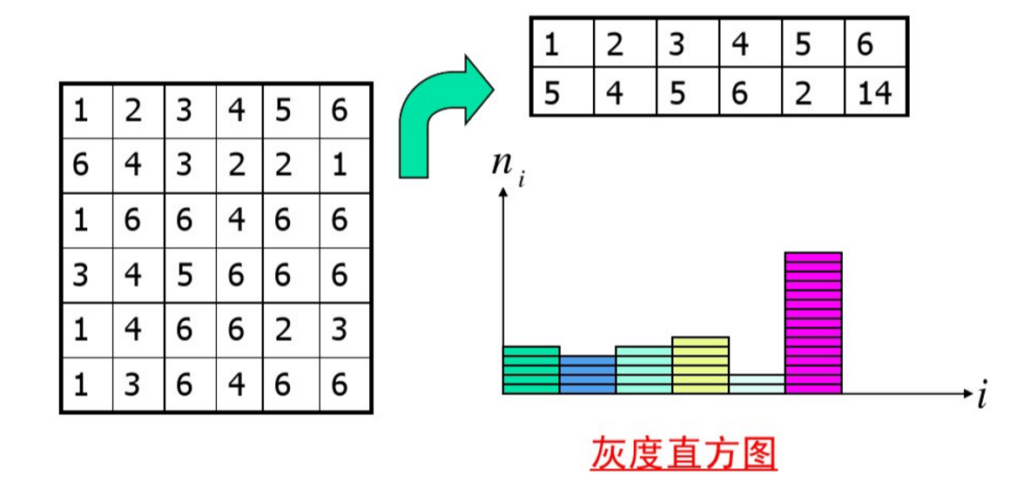
图像的直方图特征

Slide 38
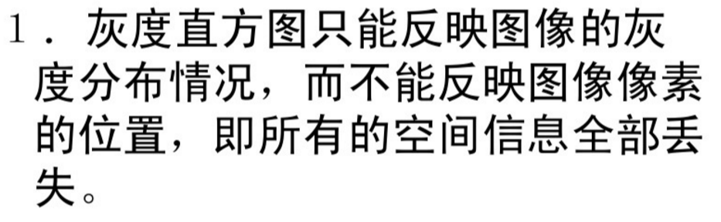
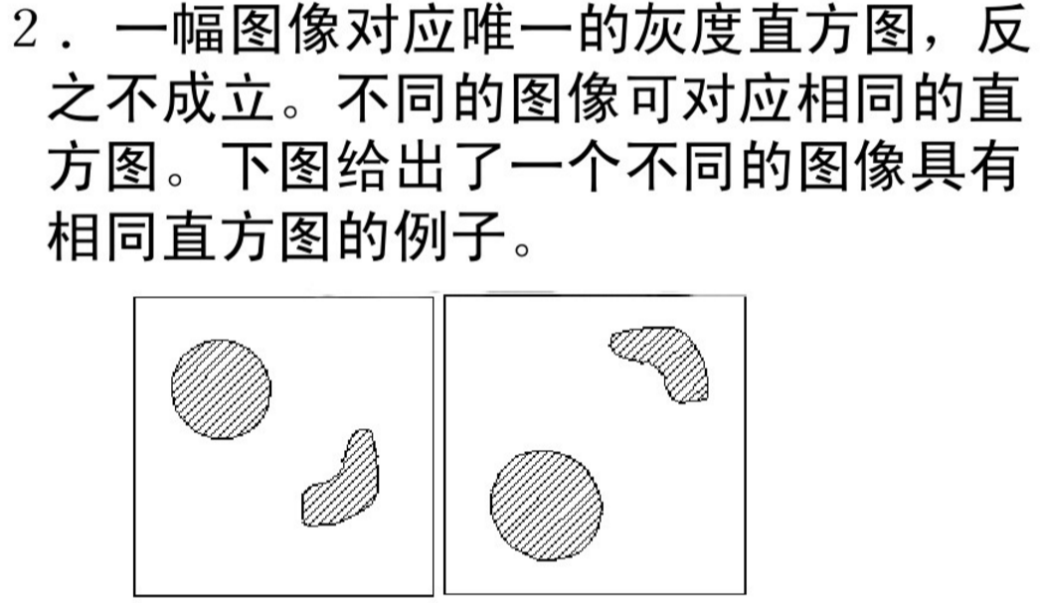
图像的直方图特征
直方图的性质

Slide 39
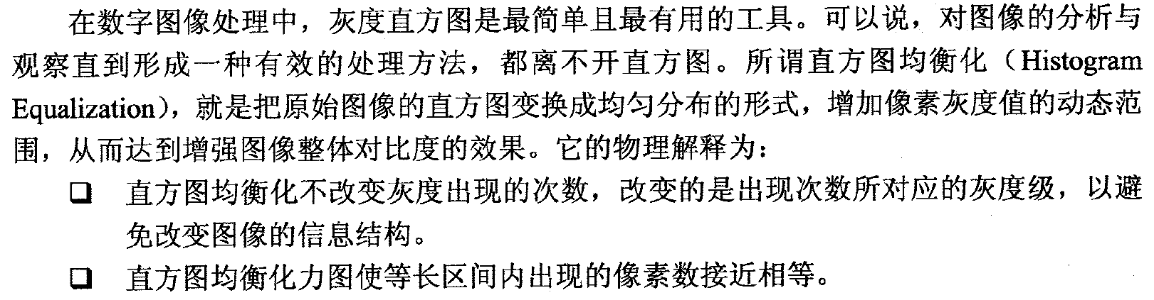
图像的点运算——直方图均衡化

Slide 40
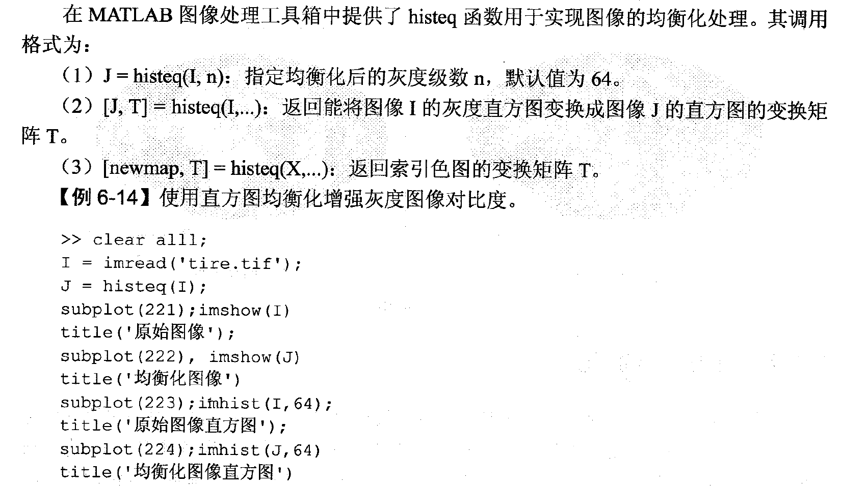
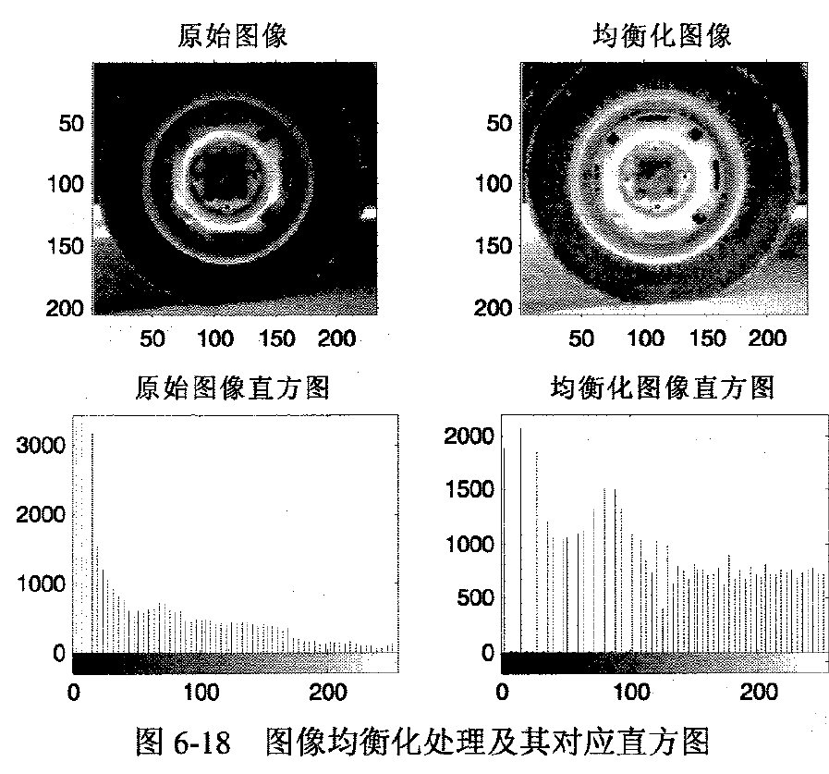
图像的点运算——直方图均衡化

Slide 41
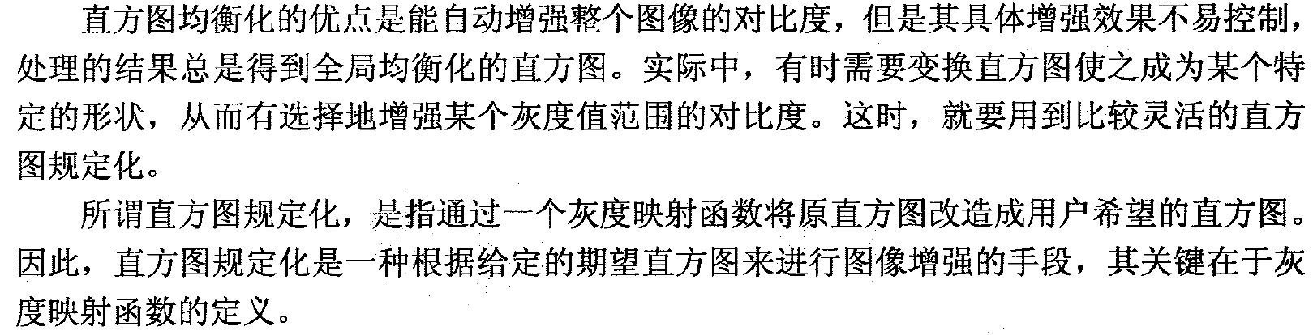
图像的点运算——直方图规定化
http://fourier.eng.hmc.edu/e161/lectures/contrast_transform/node3.html

Slide 42
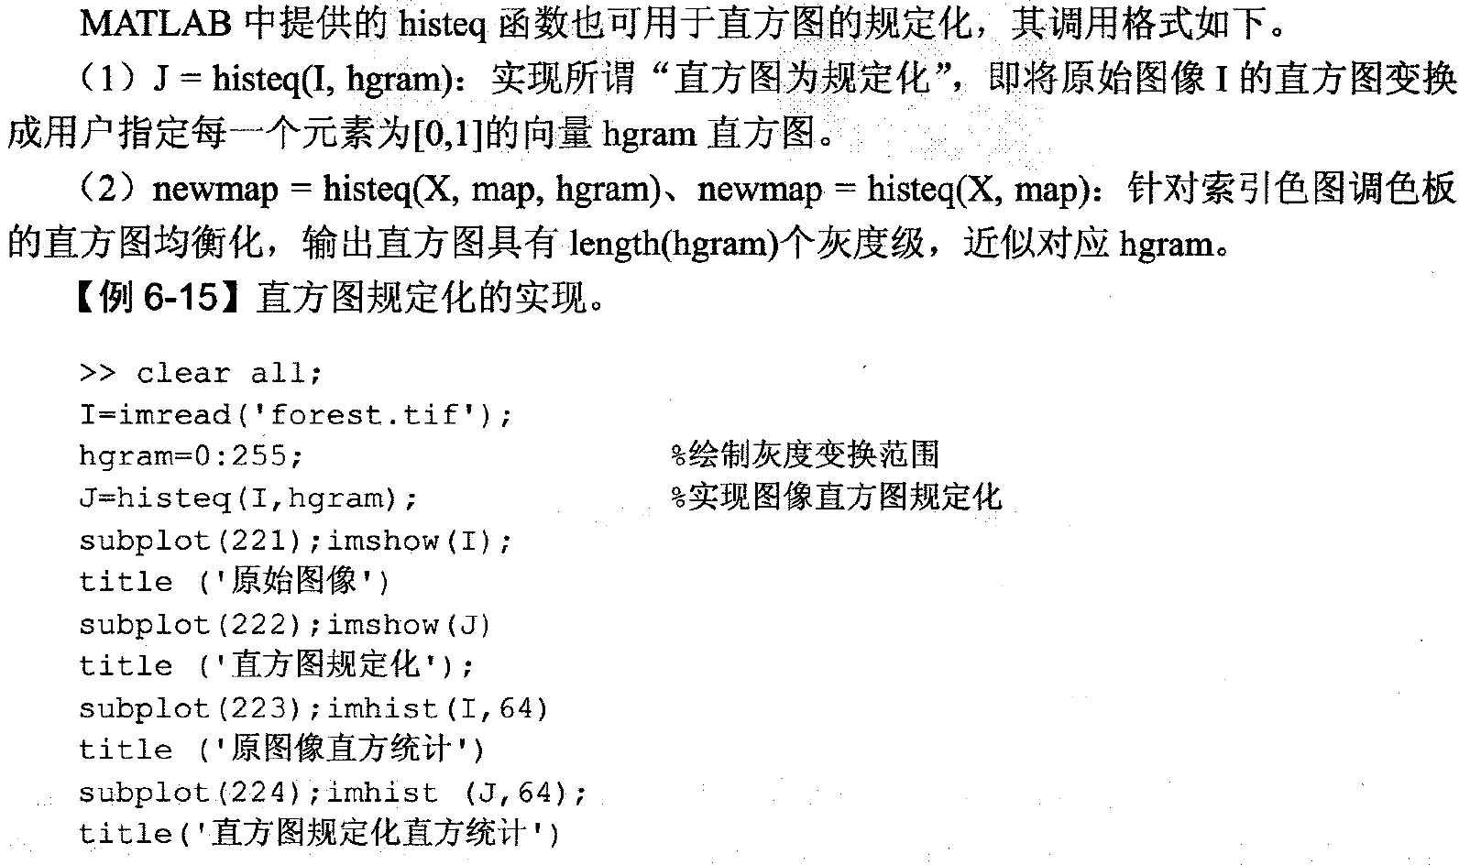
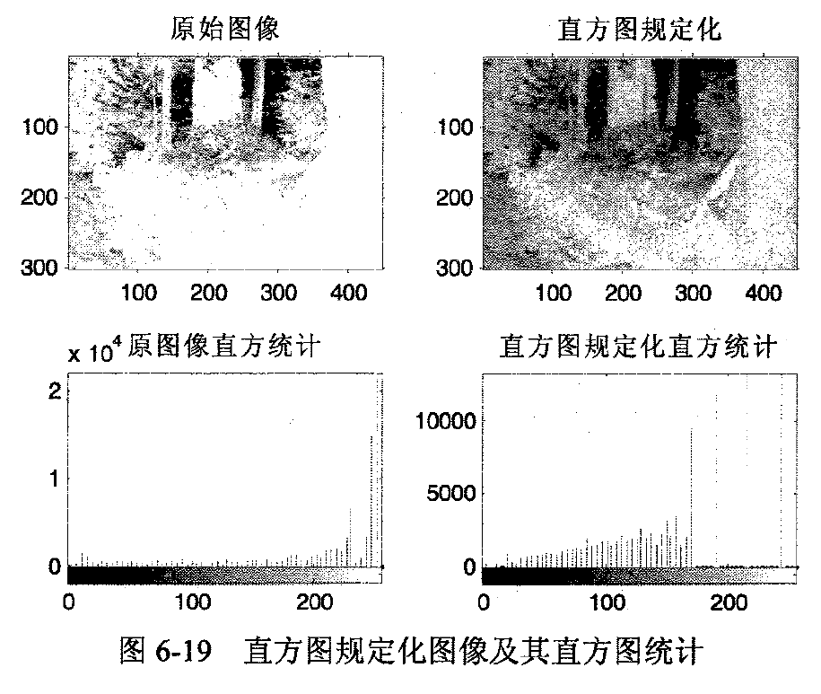
图像的点运算——直方图规定化

Slide 43
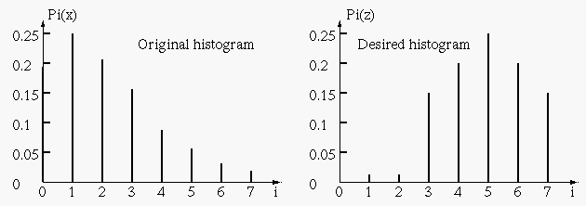
图像的点运算——直方图规定化
Example

Slide 44
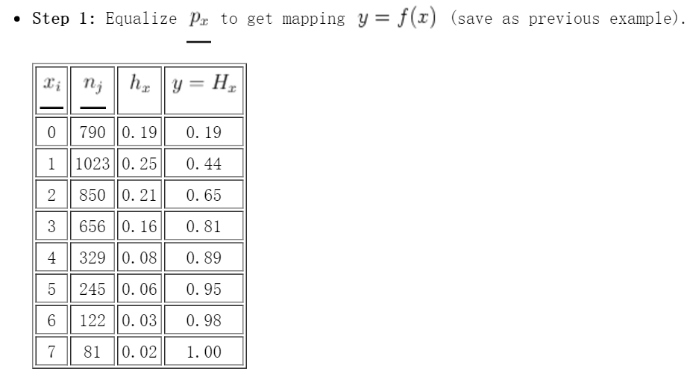
图像的点运算——直方图规定化

Slide 45
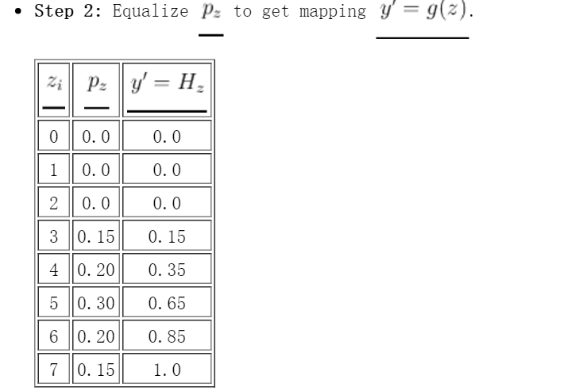
图像的点运算——直方图规定化

Slide 46
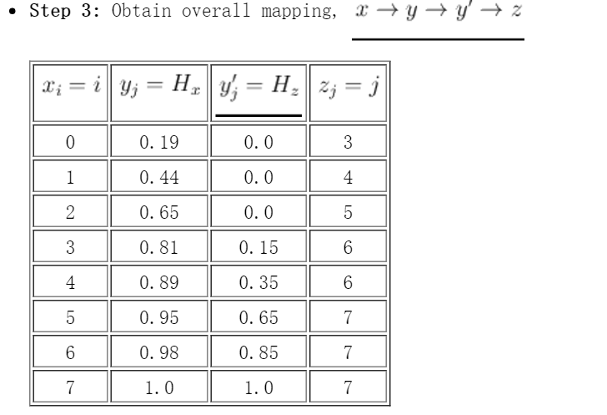
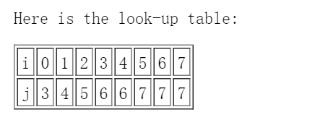
图像的点运算——直方图规定化

Slide 47


图像的点运算——直方图规定化

Slide 48

图像的点运算——直方图规定化

Slide 49

利用直方图做相似图像匹配
第一步：计算图像直方图
第二部：图像相似度计算（巴氏系数计算）

Slide 50


利用直方图做相似图像识别

Slide 51




课程实验大作业之一：
相似书法字检索：

